Slide 1
Algorithms Algorithm Analysis
CSE 464/574
Spring 2019

Slide 2
Algorithm Performance
Performance categories
Space
Time
Analysis techniques
Mathematical analysis and modeling
Experimental studies

Slide 3
Experimental studies
Experimental studies => the scientific method
Observe
Observe some feature of the world with precise measurements
Hypothesize
Produce a model that agrees with the observations
Predict
Predict event with this hypothesis
Verify
Verify the predictions with more observations
Validate
Validate by repeating until hypothesis and observations agree

Slide 4

Scientific principles
Experiments must be reproducible
Hypotheses must be falsifiable

Slide 5
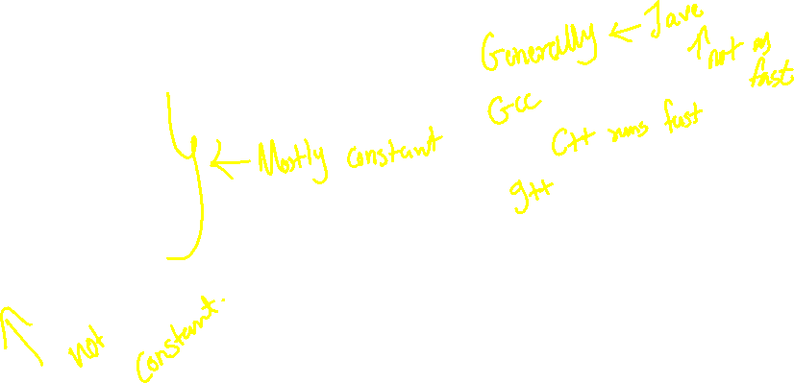
How long will a program take to run?
Does a program take the same amount of time to run each time that we run it?
What factors affect this?
Computer speed (hardware)
Other programs running
Operating system
Programming language
E.g., JVM, garbage collection
Problem size

Slide 6
Problem size
What do we mean by problem size?
E.g., size of input file
Size of file to sort
Size of a picture to process
Or value of input
E.g., Number of random numbers to generate
E.g., number of node and edges in a graph for which we are solving a shortest path problem
How does the input itself affect the running time?
For many problems, the running time is relatively insensitive to the input itself.
But not always

Slide 7
ThreeSum.java
public static int count(int[] a) {
int n = a.length;
int count = 0;
for (int i = 0; i < n; i++) {
for (int j = i+1; j < n; j++) {
for (int k = j+1; k < n; k++) {
if (a[i] + a[j] + a[k] == 0) {
count++;
}
}
}
}
return count;
}

Slide 8
Measuring the running time
Manually?
With a stopwatch
By using the program to time itself
Stopwatch class
Stopwatch() - constructor that starts the time
Double elapsedTime() – returns the time in seconds

Slide 9
public class Stopwatch {
private final long start;
/**
* Initializes a new stopwatch.
*/
public Stopwatch() {
start = System.currentTimeMillis();
}
/**
* Returns the elapsed CPU time (in seconds) since the stopwatch was created.
* @return elapsed CPU time (in seconds) since the stopwatch was created
*/
public double elapsedTime() {
long now = System.currentTimeMillis();
return (now - start) / 1000.0;
}

Slide 10
// sum of square roots of integers from 1 to n using Math.sqrt(x).
// from Sedgewick and Wayne
Stopwatch timer = new Stopwatch();
double sum = 0.0;
for (int i = 1; i <= n; i++) {
sum += Math.sqrt(i);
}
double time = timer.elapsedTime();
StdOut.printf("%e (%.2f seconds)\n", sum1, time1);

Slide 11
// Example from Sedgewick and Wayne
public static void main( String[] args) {
int N = Integer.parseInt(arg[0]);
int[] a = new int[N];
for (int i= 0; I < N; i++ )
a[i] = StdRandom.uniform( -1000000, 1000000 );
Stopwatch timer = new Stopwatch();
int cnt = ThreeSum.count(a);
double time = timer.elapsedTime();
StdOut.println(cnt + “ triples “ + time);
}

Slide 12
Empirical Analysis
N | Time (seconds) | Triples found
1000 | 0.103 | 70
2000 | 0.706 | 528
4000 | 5.614 | 4039
8000 | 44.017 | 32074
16,000 | ? | ?
32,000 | ? | ?

Slide 13
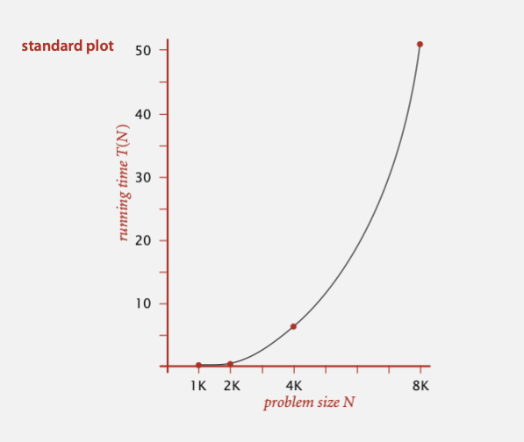


Slide 14
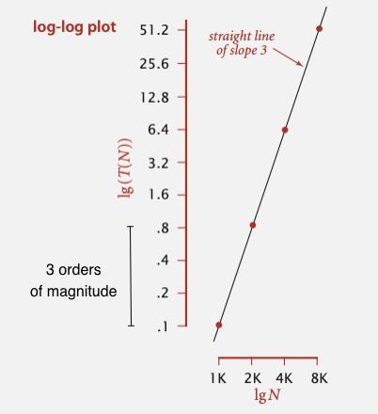

Slide 16
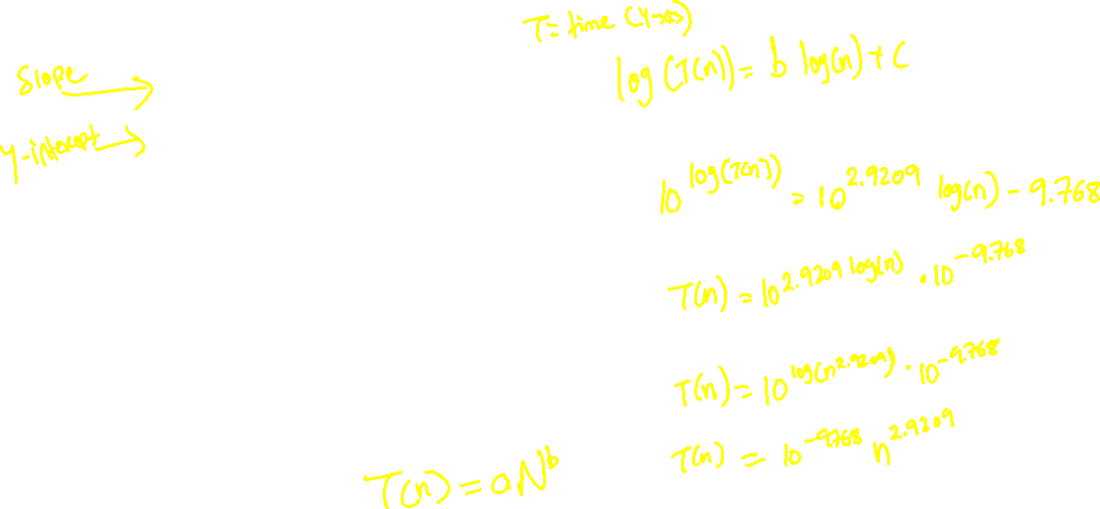


Power Law
log (T(n)) = b log(n) + c
b = 2.9209
c = -9.768
T(n) = a N^{b} where a = 2^{c}
T(n) = 10 ^{-9.768} N ^{2.9209} = 1.76 x 10⁻¹⁰ N ^{2.9209}
Hypothesis:
the running time of ThreeSum.java is about 1.76 x 10-10 N ^{2.9209}

Slide 17
Compare experimental to predicted
2.77702385
N | Time (experimental) | Predicted
1000 | 0.103 | 0.09878705
2000 | 0.706 | 0.74813249
4000 | 5.614 | 5.66574506
8000 | 44.017 | 42.9077304
16,000 | ? | 324.948141
32,000 | ? | 2460.8921
Now validate the hypothesis by collecting data 16K and 32K files
16K – 346.008 seconds

Slide 18
DoublingTest
public static double timeTrial(int n) {
int[] a = new int[n];
for (int i = 0; i < n; i++) {
a[i] = StdRandom.uniform(-MAXIMUM_INTEGER, MAXIMUM_INTEGER);
}
Stopwatch timer = new Stopwatch();
ThreeSum.count(a);
return timer.elapsedTime();
}

Slide 19


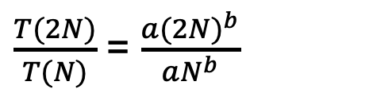


Doubling
Time | Ratio | Log 2 of ratio
0.103 | 6.85436893 | 2.77702385
0.706 | 7.95184136 | 2.99128898
5.614 | 7.84057713 | 2.97095985
44.017 | 7.86078106 | 2.97467267
346.008
$\frac{T(2N)}{T(N)}$ = $\frac{a{(2N)}^{b}}{aN^{b}}$
Hypothesis: Running time is about a*N^{b} where b is the lg (ratio)
Caveat: we cannot identify logarithmic factors with this doubling hypothesis.
= 2^{b}

Slide 20
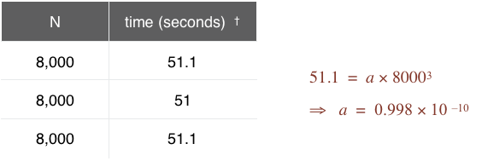

Doubling Hypothesis
Doubling hypothesis
Gives a quick way to estimate b (the exponent) in a power-law relationship
What about an estimate for a?
Run the program several times for sufficiently large value of N
Then solve for a

Slide 21
Experimentation to study algorithms
System independent events
Algorithm
Input data
These two determine the exponent in the power law
System dependent effects
Hardware: CPU, memory cache, etc.
Software: compiler, interpreter, garbage collector, etc.
System: operating system, network, other apps, etc.
All of these determine the constant in the power law.

